Slide 1
Combinator selector

Slide 2
Agenda
Combinator selector
Sample output
Combinator selector implementation

Slide 3
Combinator selector
The Combinator selector has more than one simple selector with a combinator which explains the relation between the two selectors.
There are four combinators in CSS. They are:
Descendant Selector (space)
Child Selector (>)
Adjacent Sibling Selector (+)
General Sibling Selector (~)

Slide 4
Combinator selector
Descendant Selector (space)
Descendant Selector has two simple selectors with space in between them.
Syntax:
Selector_1 Selector_2{ property: value}
Here all the Selector_2 tags are styled which are in the Selector_1 tag.
Example:
div p{background-color: green}
Here all the p tags are styled which are in the div tag.

Slide 5
Combinator selector
Example:
<style> div p{background-color: orange} </style>
<div>
<p>Paragraph 1 in the div.</p> // this will be styled
<p>Paragraph 2 in the div.</p> // this will be styled
<ul>
<p>Paragraph 3 in the div (inside an unordered list element).</p> // this will also be styled
</ul>
<p>Paragraph 4 in the div.</p> // this will be styled
</div>
<p>Paragraph 5. Not in a div.</p>
<p>Paragraph 6. Not in a div.</p>

Slide 6
Combinator selector
2. Child Selector (>):
The Child selector have a greater than symbol between two selectors.
Syntax:
Selector_1 > Selector_2{property: value}
Selects all the child elements (Selector_2) of the parent element (Selector_1)
This will not select the child elements of other tags in the selector_1 tag.

Slide 7
Combinator selector
Example:
<style> div > p{background-color: orange} </style>
<div>
<p>Paragraph 1 in the div.</p> // this will be styled
<p>Paragraph 2 in the div.</p> // this will be styled
<ul>
<p>Paragraph 3 in the div (inside an unordered list element).</p>
</ul>
<p>Paragraph 4 in the div.</p> // this will be styled
</div>
<p>Paragraph 5. Not in a div.</p>
<p>Paragraph 6. Not in a div.</p>

Slide 8
Combinator selector
3. Adjacent Sibling Selector (+):
Selects first element after a particular element.
Syntax:
Selector_1 + Selector_2 {property: value}
First Selector_2 will be styled after Selector_1

Slide 9
Combinator selector
Example:
<div>
<p>Paragraph 1 in the div.</p>
<p>Paragraph 2 in the div.</p>
</div>
<p>Paragraph 3. After a div.</p> // this will be styled
<p>Paragraph 4. After a div.</p>
<div>
<p>Paragraph 5 in the div.</p>
<p>Paragraph 6 in the div.</p>
</div>
<p>Paragraph 7. After a div.</p> // this will be styled
<p>Paragraph 8. After a div.</p>
div + p {
background-color: yellow;
}

Slide 10
Combinator selector
General Sibling Selector (~):
This selects all the next siblings of a selector.
Syntax:
Selector_1 ~ Selector_2{property: value}
All the Selector_2 are styled which comes after the Selector_1.

Slide 11
Combinator selector
div ~ p {
background-color: yellow;
}
Example:
<div>
<p>Paragraph 2.</p>
</div>
<p>Paragraph 3.</p> // this is styled
<code>Some code.</code>
<p>Paragraph 4.</p> // this is styled

Slide 12
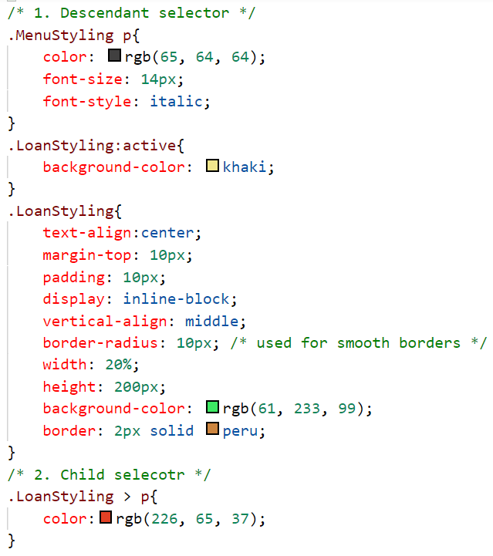
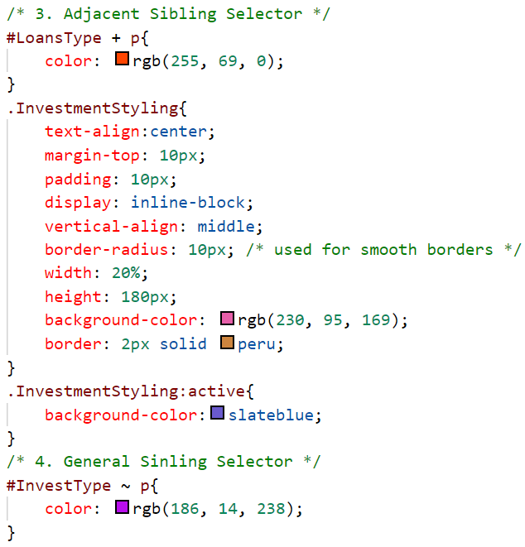
Sample output

Slide 13
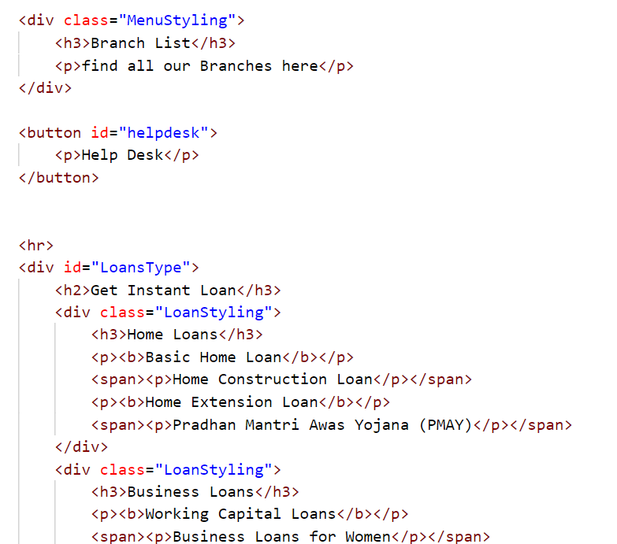
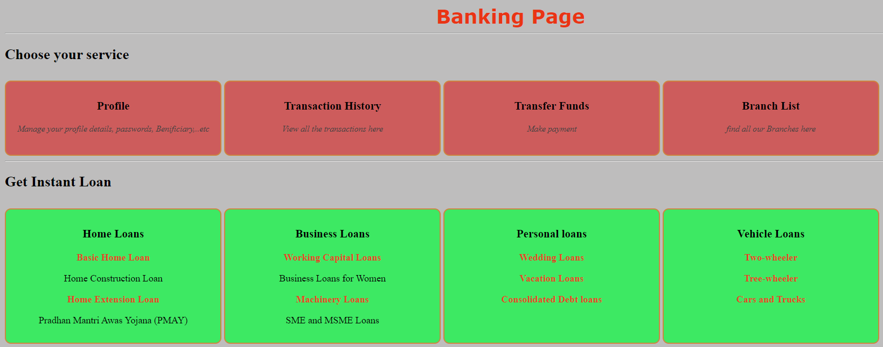
Sample output

Slide 14
Combinator selector implementation
Lets see the implementation of Combinator selectors.

Slide 15
Summary
There are various types of Combinator selectors which can style html tags in various ways.
We have seen the implementation for the same.
DO NOT WRITE ANYTHING
HERE. LEAVE THIS SPACE FOR
WEBCAM

Slide 16
Thank You
Proprietary content. ©Great Learning. All Rights Reserved. Unauthorized use or distribution prohibited

